Slide 1
Module 19: Implement Site-to-Site IPsec VPNs with CLI
Networking Security v1.0
(NETSEC)
Notes:
Networking Security (NETSEC) Module 19: Implement Site-to-Site IPsec VPNs with CLI

Slide 2
Module Objectives
Module Title: Implement Site-to-Site IPsec VPNs with CLI
Module Objective: Configure a site-to-site IPsec VPN, with pre-shared key authentication, using CLI.
Topic Title | Topic Objective
Configure a Site-to-Site IPsec VPN | Describe IPsec negotiation and the five steps of IPsec configuration.
ISAKMP Policy | Use the correct commands to configure an ISAKMP policy.
IPsec Policy | Use the correct commands to configure the IPsec policy.
Crypto Map | Use the correct command to configure and apply a Crypto map.
IPsec VPN | Configure the IPsec VPN.
Notes:
2
19 – Implement Site-to-Site IPsec VPNs with CLI
19.0.2 – What will I learn to do in this module?

Slide 3
19.1 Configure a Site-to-Site IPsec VPN
Notes:
19: Implement Site-to-Site IPsec VPNs with CLI 19.1: Configure a Site-to-Site IPsec VPN

Slide 4
Configure a Site-to-Site IPsec VPN
IPsec Negotiation
IPsec negotiation to establish a VPN involves five steps, which include IKE Phase 1 and Phase 2:
An ISAKMP tunnel is initiated when host A sends “interesting” traffic to host B. Traffic is considered interesting when it travels between the peers and meets the criteria that are defined in an ACL.
IKE Phase 1 begins. The peers negotiate the ISAKMP SA policy. When the peers agree on the policy and are authenticated, a secure tunnel is created.
IKE Phase 2 begins. The IPsec peers use the authenticated secure tunnel to negotiate the IPsec SA policy. The negotiation of the shared policy determines how the IPsec tunnel is established.
The IPsec tunnel is created, and data is transferred between the IPsec peers based on the IPsec SAs.
The IPsec tunnel terminates when the IPsec SAs are manually deleted, or when their lifetime expires.
Notes:
19: Implement Site-to-Site IPsec VPNs with CLI 19.1: Configure a Site-to-Site IPsec VPN 19.1.1: IPsec Negotiation

Slide 5
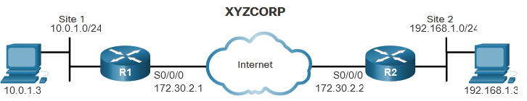
Configure a Site-to-Site IPsec VPN
Site-to-Site IPsec VPN Topology
Implementing a site-to-site VPN requires configuring settings for both IKE Phase 1 and Phase 2. In the phase 1 configuration, the two sites are configured with the necessary ISAKMP security associations to ensure that an ISAKMP tunnel can be created. In the phase 2 configuration, the two sites are configured with the IPsec security associations to ensure that an IPsec tunnel is created within the ISAKMP tunnel. Both tunnels will be created only when interesting traffic is detected.
The topology in the figure for XYZCORP will be used in this section to demonstrate a site-to-site IPsec VPN implementation.
Notes:
19: Implement Site-to-Site IPsec VPNs with CLI 19.1: Configure a Site-to-Site IPsec VPN 19.1.2: Site-to-Site IPsec VPN Topology

Slide 6
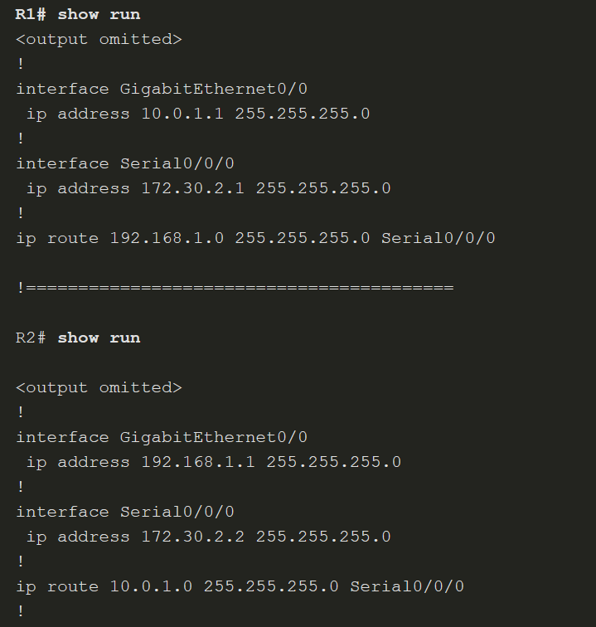
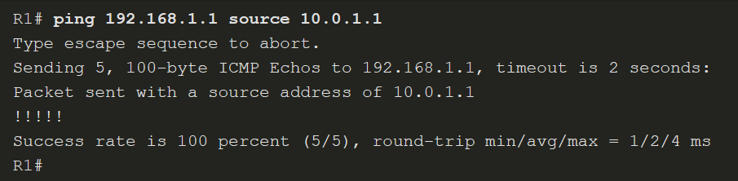
Configure a Site-to-Site IPsec VPN
Site-to-Site IPsec VPN Topology (Cont.)
Both routers are configured with IP addressing and static routing. An extended ping on R1 verifies that routing between the LANs is operational.
Notes:
19: Implement Site-to-Site IPsec VPNs with CLI 19.1: Configure a Site-to-Site IPsec VPN 19.1.2: Site-to-Site IPsec VPN Topology (Cont.)

Slide 7
Configure a Site-to-Site IPsec VPN
IPsec VPN Configuration Tasks
Security Policy Requirements
All XYZCORP VPNs should be implemented using the following security policy:
Encrypt traffic with AES 256 and SHA.
Authenticate with PSK.
Exchange keys with DH group 14.
ISAKMP tunnel lifetime is 1 hour.
IPsec tunnel uses ESP with a 15-minute lifetime.
Configuration Tasks:
The configuration tasks required to meet this policy are:
Task 1: Configure the ISAKMP Policy for IKE Phase 1
Task 2: Configure the IPsec Policy for IPsec Phase 2
Task 3: Configure a Crypto Map for the IPsec Policy
Task 4: Apply the IPsec Policy
Task 5: Verify that the IPsec Tunnel is Operational
Notes:
19: Implement Site-to-Site IPsec VPNs with CLI 19.1: Configure a Site-to-Site IPsec VPN 19.1.3: IPsec VPN Configuration Tasks

Slide 8
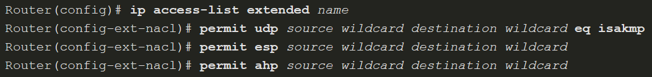
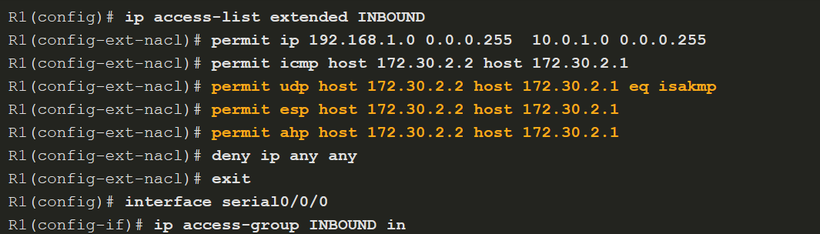
Configure a Site-to-Site IPsec VPN
Existing ACL Configurations
Prior to implementing a site-to-site IPsec VPN, ensure that the existing ACLs do not block traffic necessary for IPsec negotiations. The ACL command syntax to permit ISAKMP, ESP, and AH traffic is shown here.
Notes:
19: Implement Site-to-Site IPsec VPNs with CLI 19.1: Configure a Site-to-Site IPsec VPN 19.1.4: Existing ACL Configurations

Slide 9
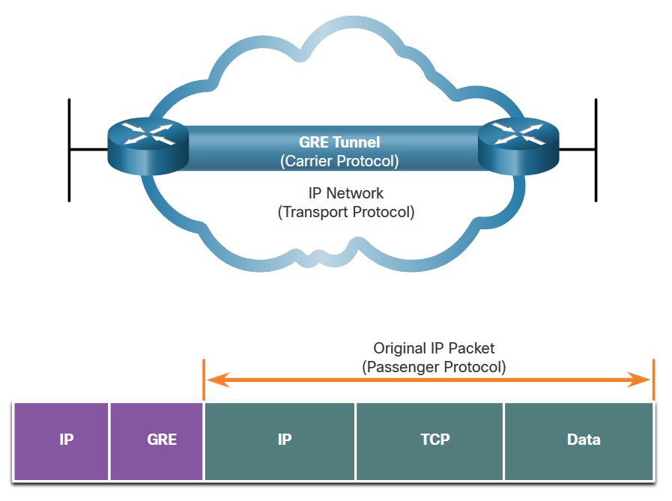
Configure a Site-to-Site IPsec VPN
Handling Broadcast and Multicast Traffic
The XYZCORP topology uses static routing, so there is no multicast or broadcast traffic that needs to be routed through the tunnel. But what if XYZCORP decided to implement EIGRP or OSPF? To enable routing protocol traffic, the peers in a site-to-site IPsec VPN implementation would need to be configured with a Generic Routing Encapsulation (GRE) tunnel for the multicast traffic.
Notes:
19: Implement Site-to-Site IPsec VPNs with CLI 19.1: Configure a Site-to-Site IPsec VPN 19.1.5: Handling Broadcast and Multicast Traffic
19.1.6: Check Your Understanding – Identify the IPsec Negotiation Steps

Slide 10
19.2 ISAKMP Policy
Notes:
19: Implement Site-to-Site IPsec VPNs with CLI 19.2: ISAKMP Policy

Slide 11
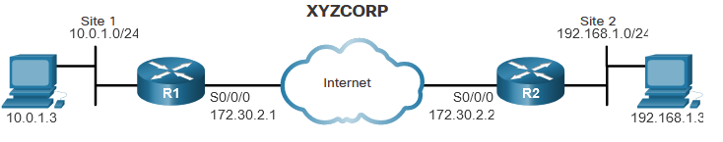
ISAKMP Policy
The Default ISAKMP Policies
The Cisco IOS comes with default ISAKMP policies already in place. To view the default policies, enter the show crypto isakmp default policy command.
R1 has seven default ISAKMP policies ranging from the most secure (policy 65507) to the least secure (policy 65514). If no other policy has been defined by the administrator, R1 will attempt to use the most secure default policy. If R2 has a matching policy, then R1 and R2 can successfully negotiate the IKE Phase 1 ISAKMP tunnel without any configuration by the administrator.
Notes:
19: Implement Site-to-Site IPsec VPNs with CLI 19.2: ISAKMP Policy 19.2.1: The Default ISAKMP Policies

Slide 12
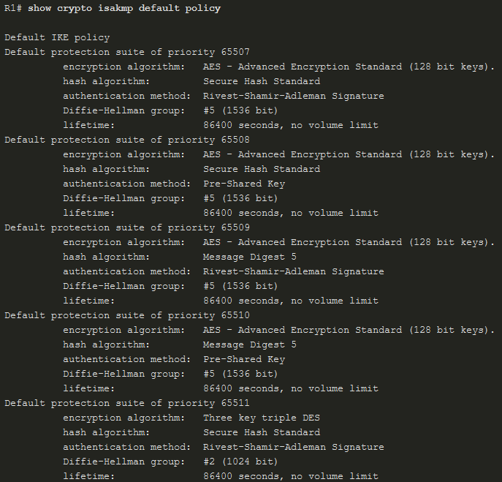
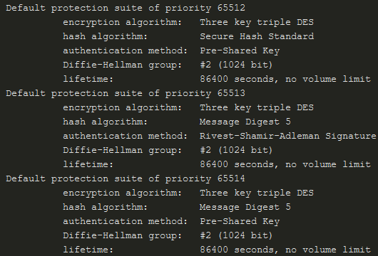
ISAKMP Policy
The Default ISAKMP Policies (Cont.)
In this example, none of the default policies match the security policy for XYZCORP. A new ISAKMP policy will have to be configured.
Notes:
19: Implement Site-to-Site IPsec VPNs with CLI 19.2: ISAKMP Policy 19.2.1: The Default ISAKMP Policies (Cont.)

Slide 13
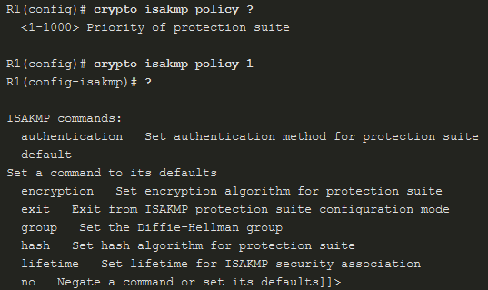
ISAKMP Policy
Syntax to Configure a New ISAKMP Policy
To configure a new ISAKMP policy, use the crypto isakmp policy command. The only argument for the command is to set a priority for the policy (from 1 to 10000). Peers will attempt to negotiate using the policy with the lowest number (highest priority).
When in ISAKMP policy configuration mode, the SAs for the IKE Phase 1 tunnel can be configured. Use the mnemonic HAGLE to remember the five SAs to configure:
Hash
Authentication
Group
Lifetime
Encryption
Notes:
19: Implement Site-to-Site IPsec VPNs with CLI 19.2: ISAKMP Policy 19.2.2: Syntax to Configure a New ISAKMP Policy

Slide 14
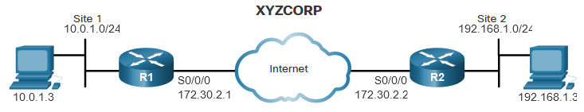
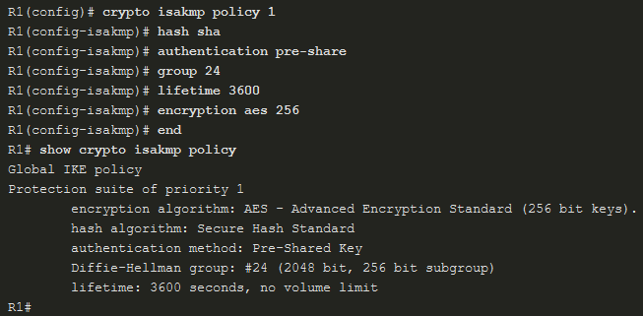
ISAKMP Policy
ISAKMP Policy Configuration
To meet the security policy requirements for XYZCORP, configure the ISAKMP policy with the following SAs:
Hash is SHA
Authentication is pre-shared key
Group is 14
Lifetime is 3600 seconds
Encryption is AES
Notes:
19: Implement Site-to-Site IPsec VPNs with CLI 19.2: ISAKMP Policy 19.2.3: ISAKMP Policy Configuration

Slide 15
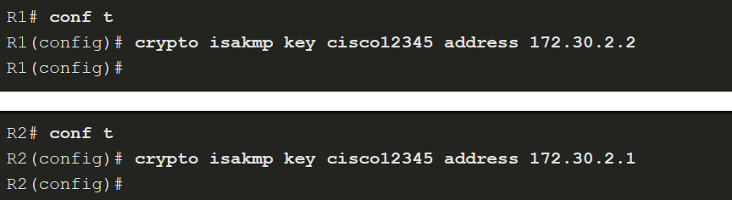
ISAKMP Policy
Configuring a Pre-Shared Key
The pre-shared key command syntax is as follows:
XYZCORP uses the key phrase cisco12345 and the IP address of the peer:
Notes:
19: Implement Site-to-Site IPsec VPNs with CLI 19.2: ISAKMP Policy 19.2.4: Configuring a Pre-Shared Key
19.2.5: Syntax Checker - Configuring a Pre-Shared Key

Slide 16
19.3 IPsec Policy
Notes:
19: Implement Site-to-Site IPsec VPNs with CLI 19.3: IPsec Policy

Slide 17
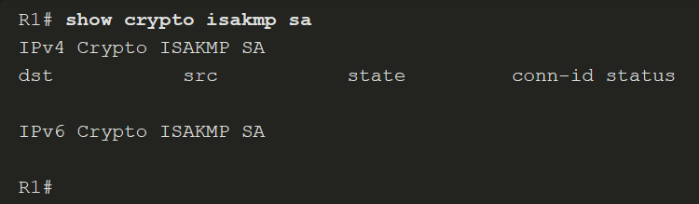
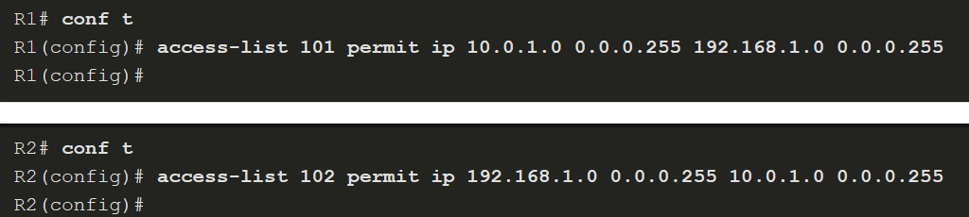
IPsec Policy
Define Interesting Traffic
Although the ISAKMP policy for the IKE Phase 1 tunnel is configured, the tunnel does not yet exist. This is verified with the show crypto isakmp sa command.
To define interesting traffic, configure each router with an ACL to permit traffic from the local LAN to the remote LAN. The ACL will be used in the crypto map configuration to specify what traffic will trigger the start of IKE Phase 1.
Notes:
19: Implement Site-to-Site IPsec VPNs with CLI 19.3: IPsec Policy 19.3.1: Define Interesting Traffic

Slide 18
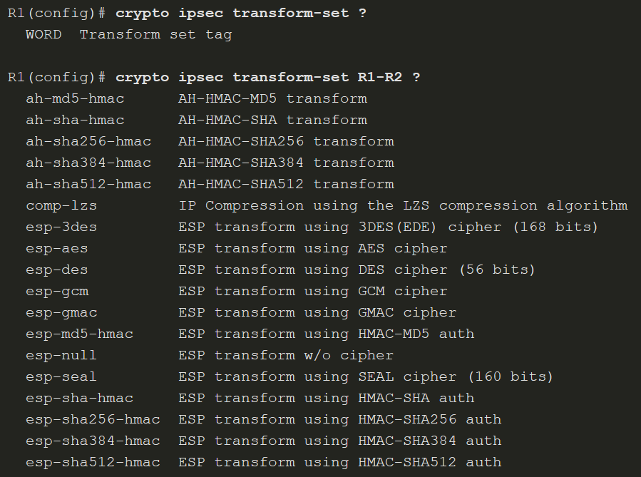
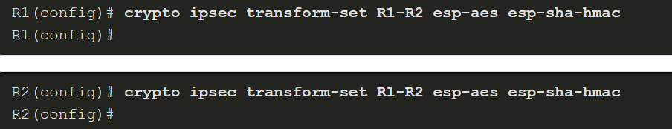
IPsec Policy
Configure IPsec Transform Set
The next step is to configure the transform set, a set of encryption and hashing algorithms that will be used to transform the data sent through the IPsec tunnel.
Configure a transform set using the crypto ipsec transform-set command. First, specify a name for the transform set (R1-R2, in the example). The encryption and hashing algorithm can then be configured in either order.
Notes:
19: Implement Site-to-Site IPsec VPNs with CLI 19.3: IPsec Policy 19.3.2: Configure IPsec Transform Set
19.3.3: Syntax Checker - Configure IPsec Transform Set

Slide 19
19.4 Crypto Map
Notes:
19: Implement Site-to-Site IPsec VPNs with CLI 19.4: Crypto Map

Slide 20
Crypto Map
Syntax to Configure a Crypto Map
Now that the interesting traffic is defined, and an IPsec transform set is configured, it is time to bind those configurations with the rest of the IPsec policy in a crypto map. The available configurations for a crypto map entry when you are in crypto map configuration mode are shown below. Although the ipsec-manual option is shown, its use is beyond the scope of this course.
Parameter | Description
map-name | Identifies the crypto map set.
seq-num | Sequence number you assign to the crypto map entry. Use the crypto map map-name seq-num command without any keyword to modify the existing crypto map entry or profile.
ipsec-isakmp | Indicates that IKE will be used to establish the IPsec for protecting the traffic specified by this crypto map entry.
ipsec-manual | Indicates that IKE will not be used to establish the IPsec SAs for protecting the traffic specified by this crypto map entry.
Notes:
19: Implement Site-to-Site IPsec VPNs with CLI 19.4: Crypto Map 19.4.1: Syntax to Configure a Crypto Map

Slide 21
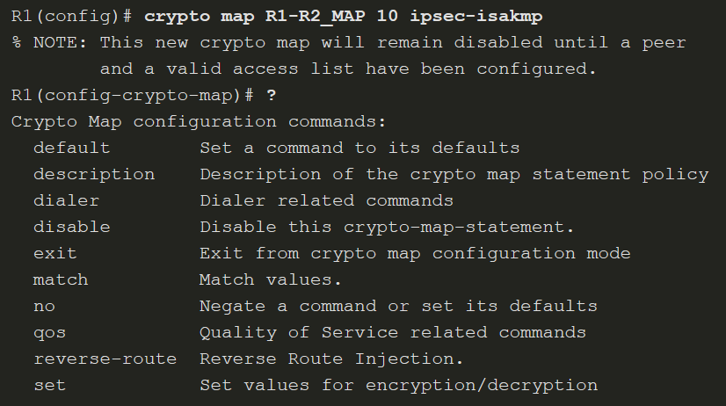
Crypto Map
Syntax to Configure a Crypto Map (Cont.)
The available configurations for a crypto map entry when you are in crypto map configuration mode are shown below. The map name is R1-R2_MAP, and the sequence number is 10.
Notes:
19: Implement Site-to-Site IPsec VPNs with CLI 19.4: Crypto Map 19.4.1: Syntax to Configure a Crypto Map (Cont.)

Slide 22
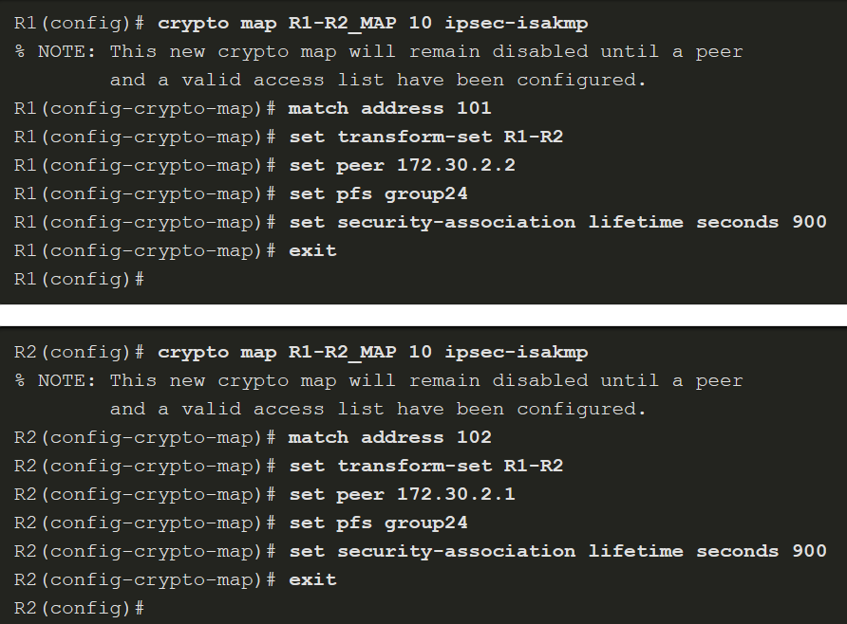
Crypto Map
Crypto Map Configuration
To finish the configuration to meet the IPsec security policy for XYZCORP, complete the following:
Step 1. Bind the ACL and the transform set to the map.
Step 2. Specify the peer’s IP address.
Step 3. Configure the DH group.
Step 4. Configure the IPsec tunnel lifetime.
Notes:
19: Implement Site-to-Site IPsec VPNs with CLI 19.4: Crypto Map 19.4.2: Crypto Map Configuration

Slide 23
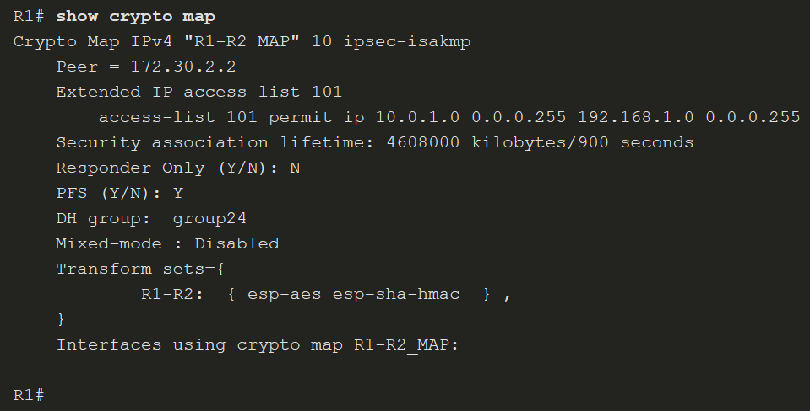
Crypto Map
Crypto Map Configuration (Cont.)
Use the show crypto map command to verify the crypto map configuration, as shown in here. All the required SAs should be in place.
Notes:
19: Implement Site-to-Site IPsec VPNs with CLI 19.4: Crypto Map 19.4.2: Crypto Map Configuration (Cont.)

Slide 24
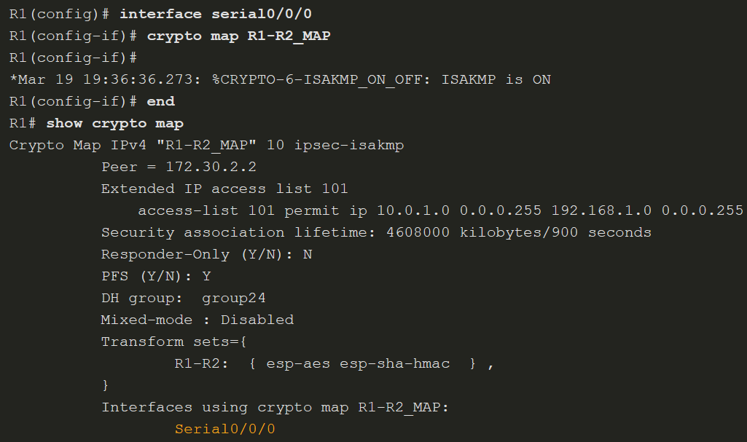
Crypto Map
Apply and Verify the Crypto Map
To apply the crypto map, Use the crypto map map-name interface configuration command to apply the crypto map.
Use the show crypto map to verify the crypto map is not applied to the interface.
Notes:
19: Implement Site-to-Site IPsec VPNs with CLI 19.4: Crypto Map 19.4.3: Apply and Verify the Crypto Map
19.4.4: Syntax Checker - Configure, Apply, and Verify the Crypto Map

Slide 25
19.5 IPsec VPN
Notes:
19: Implement Site-to-Site IPsec VPNs with CLI 19.5: IPsec VPN

Slide 26
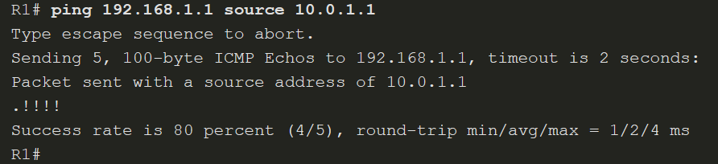
IPsec VPN
Send Interesting Traffic
Traffic from the LAN interface on R1 destined for the LAN interface on R2 is considered interesting traffic because it matches the ACLs configured on both routers. An extended ping from R1 will effectively test the VPN configuration.
Notes:
19: Implement Site-to-Site IPsec VPNs with CLI 19.5: IPsec VPN 19.5.1: Send Interesting Traffic

Slide 27
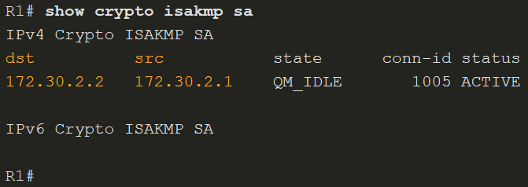
IPsec VPN
Verify the ISAKMP and IPsec Tunnels
To verify that tunnels have been established, use the show crypto isakmp sa and show crypto ipsec sa (next slide) commands.
Notes:
19: Implement Site-to-Site IPsec VPNs with CLI 19.5: IPsec VPN 19.5.2: Verify the ISAKMP and IPsec Tunnels

Slide 28
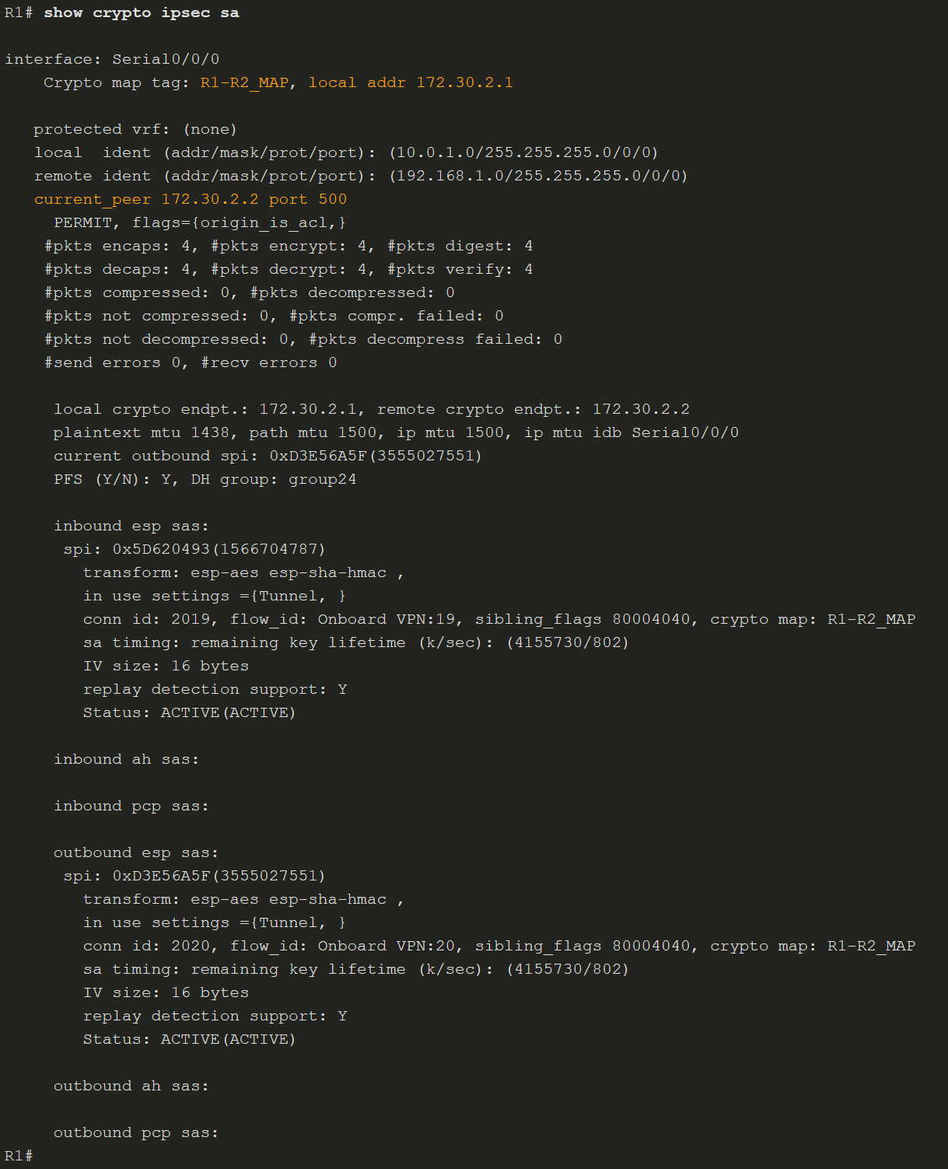
IPsec VPN
Verify the ISAKMP and IPsec Tunnels (Cont.)
The output for the ISAKMP tunnel is shown below. Notice that the tunnel is active between the two peers, 172.30.2.1 and 172.30.2.2.
Notes:
19: Implement Site-to-Site IPsec VPNs with CLI 19.5: IPsec VPN 19.5.2: Verify the ISAKMP and IPsec Tunnels (Cont.)
19.5.3: Syntax Checker - Verify the ISAKMP and IPsec Tunnels

Slide 29
IPsec VPN
Video - Site-to-Site IPsec VPN Configuration
This video will demonstrate configuring a Site-to Site IPsec VPN Tunnel.
Notes:
19: Implement Site-to-Site IPsec VPNs with CLI 19.5: IPsec VPN 19.5.4: Video - Site-to-Site IPsec VPN Configuration

Slide 30
IPsec VPN
Packet Tracer - Configure and Verify a Site-to-Site IPsec VPN
In this Packet Tracer, you will complete the following objectives:
Verify connectivity throughout the network
Configure router R1 to support to site-to-site IPsec VPN with R3
Notes:
19: Implement Site-to-Site IPsec VPNs with CLI 19.5: IPsec VPN 19.5.5: Packet Tracer - Configure and Verify a Site-to-Site IPsec VPN

Slide 31
IPsec VPN
Lab - Configuring a Site-to-Site VPN
In this lab, you will complete the following objectives:
Configure basic device settings.
Configure a site-to-site VPN using Cisco IOS.
Notes:
19: Implement Site-to-Site IPsec VPNs with CLI 19.5: IPsec VPN 19.5.6: Lab - Configuring a Site-to-Site VPN

